Slide 1
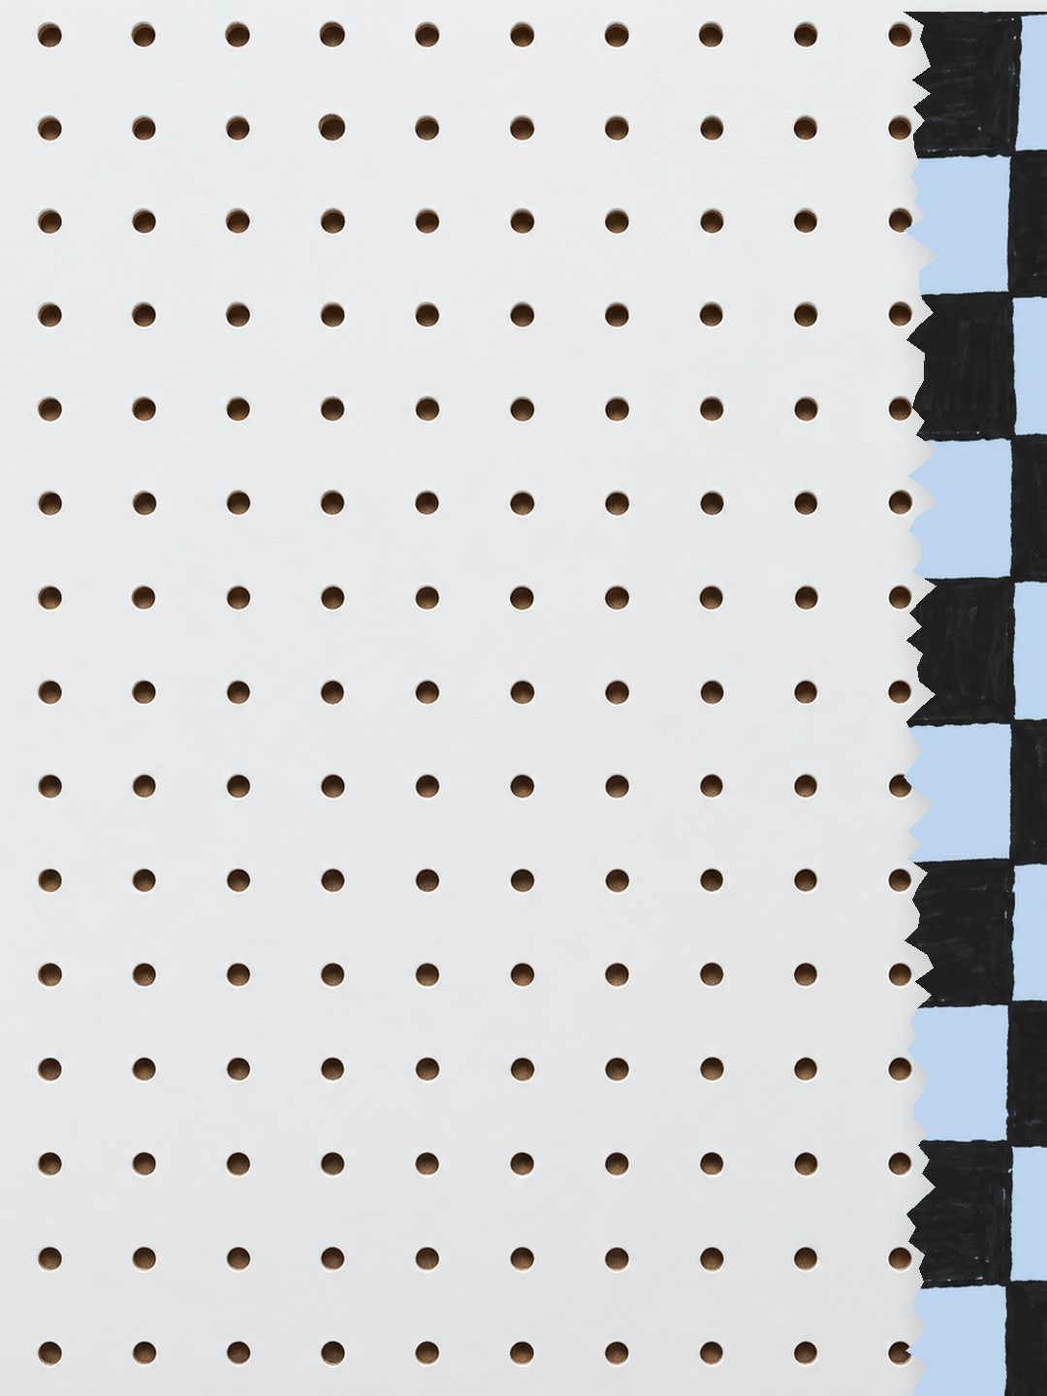




how big
is it really?
this big?
this big?
Everything blue is a guide. Delete it before you download.
Notes:
Slide 1. Hook. The same product photo three times, at three sizes. Swap in yours.

Slide 2
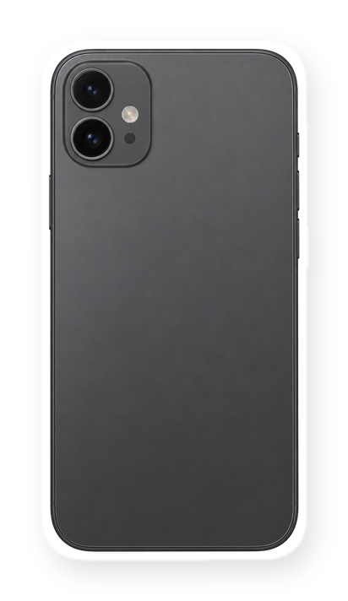
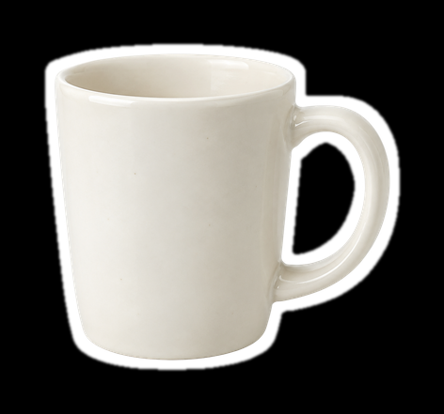
[photos lie
about size]
[6 in phone]
[mug]
[here's the real size]
Notes:
Slide 2. Second hook: Instagram often shows a carousel starting on slide 2, so this one works as a cover on its own. No photo needed. Edit the size labels and both [bracket] lines.

Slide 3

in my hand
[fits in one hand]
Notes:
Slide 3. In your hand: a full-page photo. Move the arrows to the edges of your product. Edit the line.

Slide 4
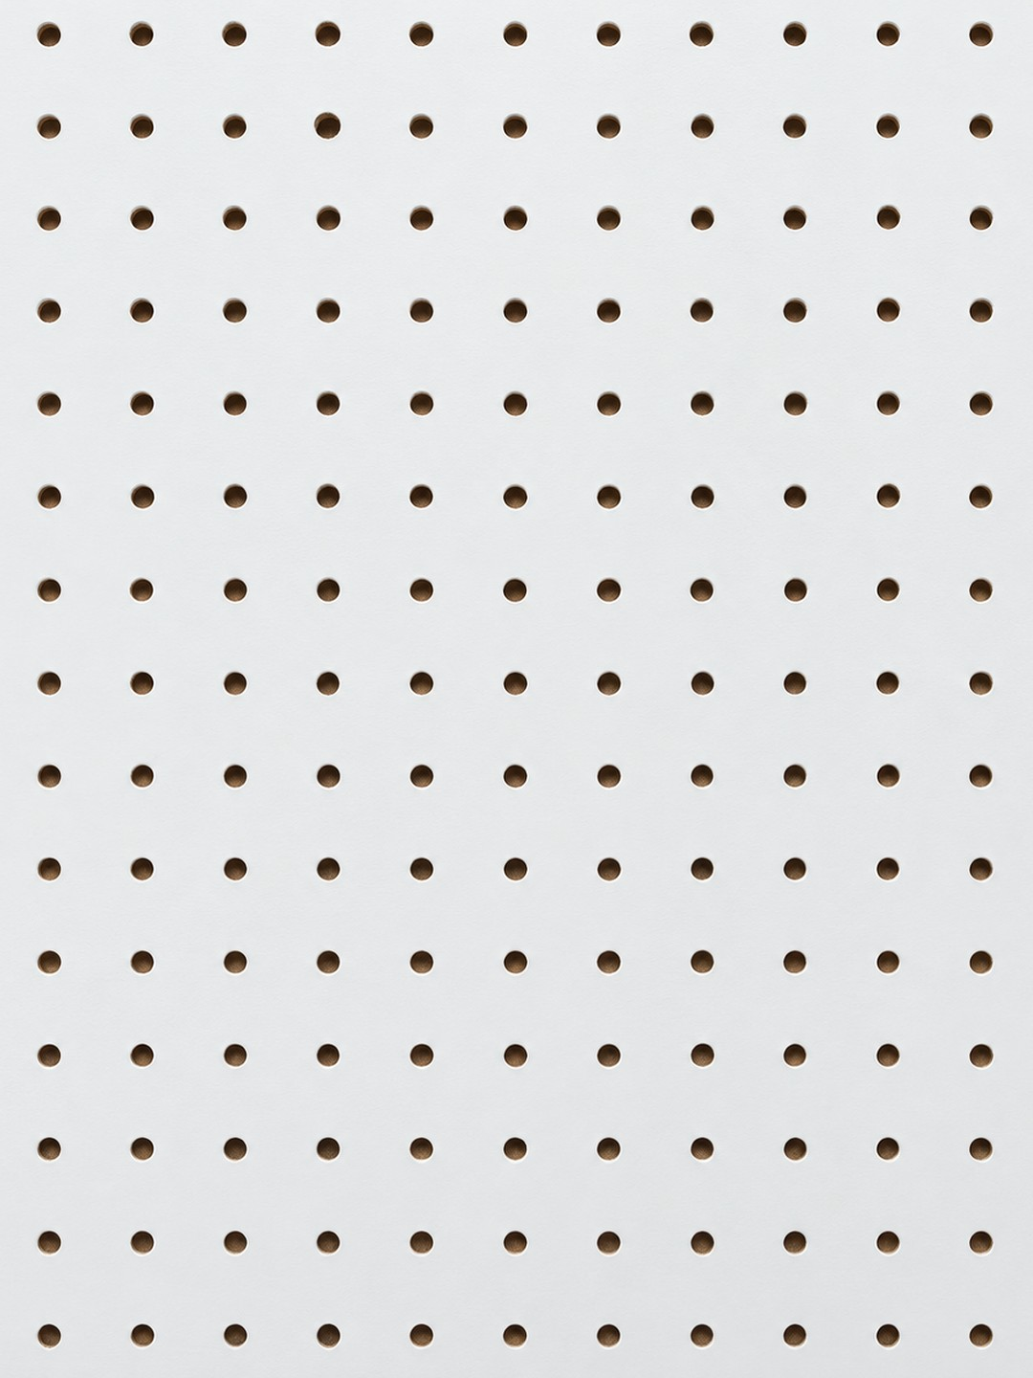
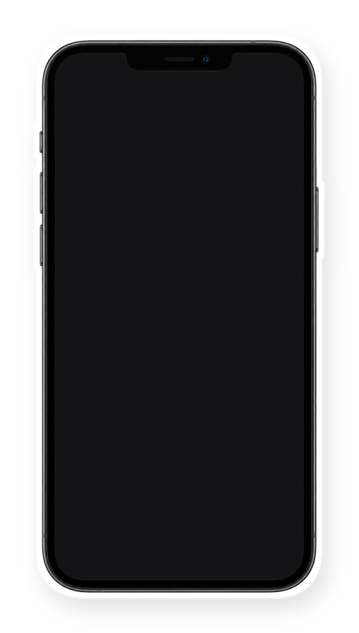



in real life
on screen
Notes:
Slide 4. Left: a screenshot of your shop photo. Right: the real thing, at the same height.

Slide 5


[the size of a
water bottle]
Notes:
Slide 5. In use: swap in its photo. Edit the line.

Slide 6


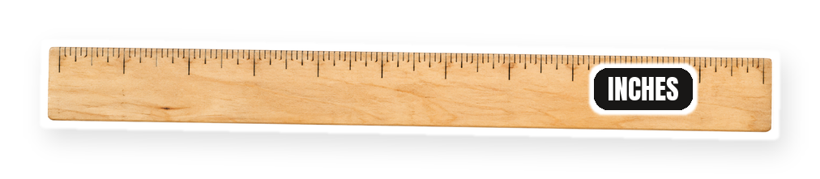
exactly
[9 x 4 in]
Notes:
Slide 6. Swap in a photo of your product on a plain surface. Type its exact size.

Slide 7


Comment
"[SIZE]"
[exact size + where to buy]
Notes:
Slide 7. Swap in your product photo. Type your keyword. Caption to start from (CTA in the first two sentences, 3 hashtags): Comment [KEYWORD] and I will send you [the link]. [One line of real context: who it helps or how you use it.] #[tag] #[tag] #[tag]

